Slide 1
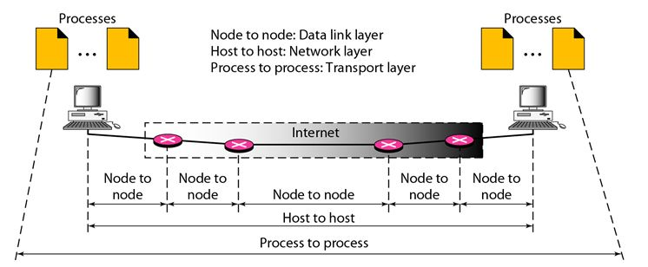
Intermediate Node (중계 노드)
(End to End, Network Layer)
(Transport Layer)
IDS
Firewall
Router
OSI 7 Layer
Transport Layer
(Port)
Session Layer
(Session)
Network Layer
(IP)

